Slide 1
Discrete Fourier Transform (DFT)
Tirgul 6

Slide 2

Introduction - complex numbers

Slide 3
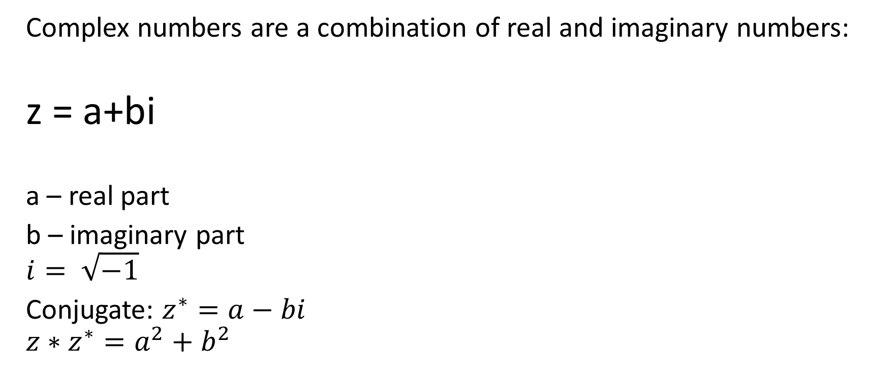
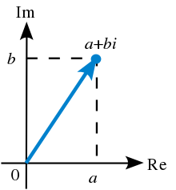
Complex Numbers

Slide 4
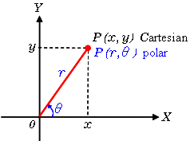
Polar form
Any vector can be represented in a polar form (r, theta), amplitude and angle, or in a cartesian form (x,y)

Slide 5
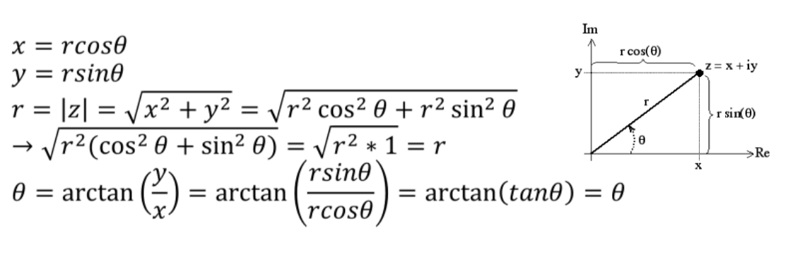
Polar form
Any vector can be represented in a polar form (r, theta), amplitude and angle, or in a cartesian form (x,y)

Slide 6
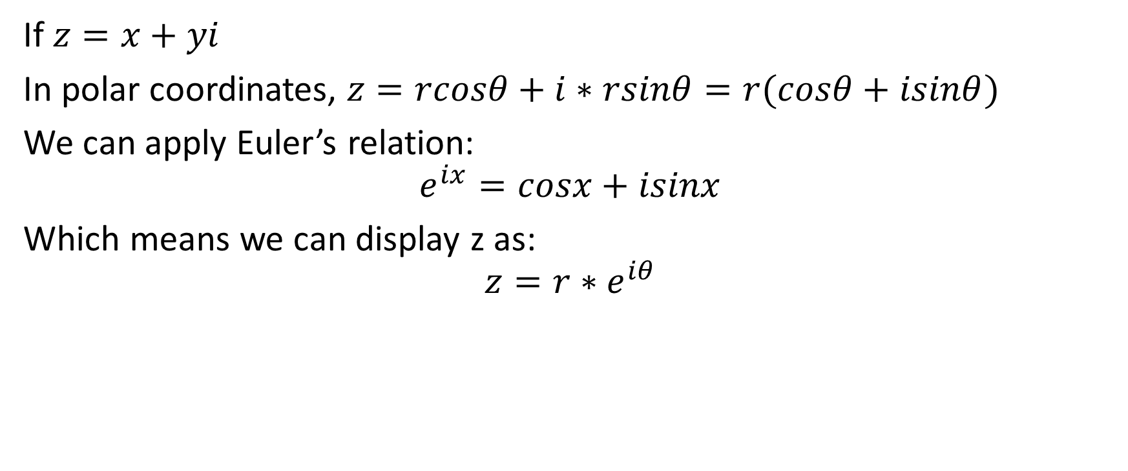
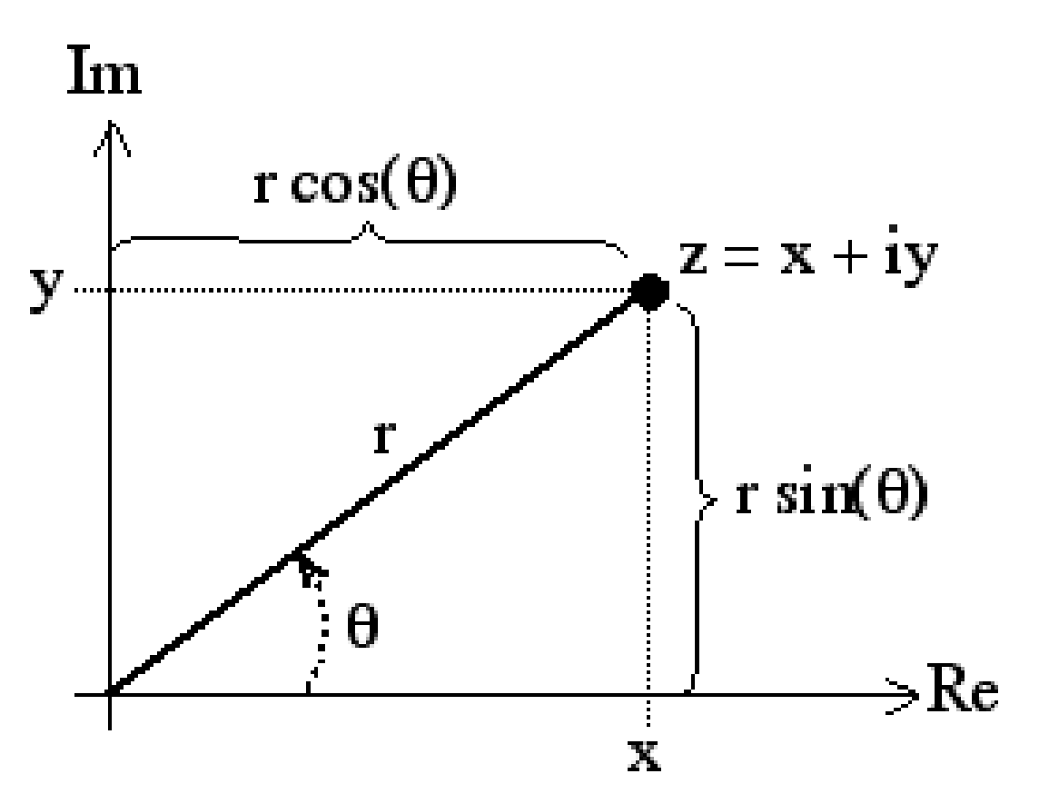
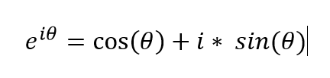

Complex numbers in polar form

Slide 7
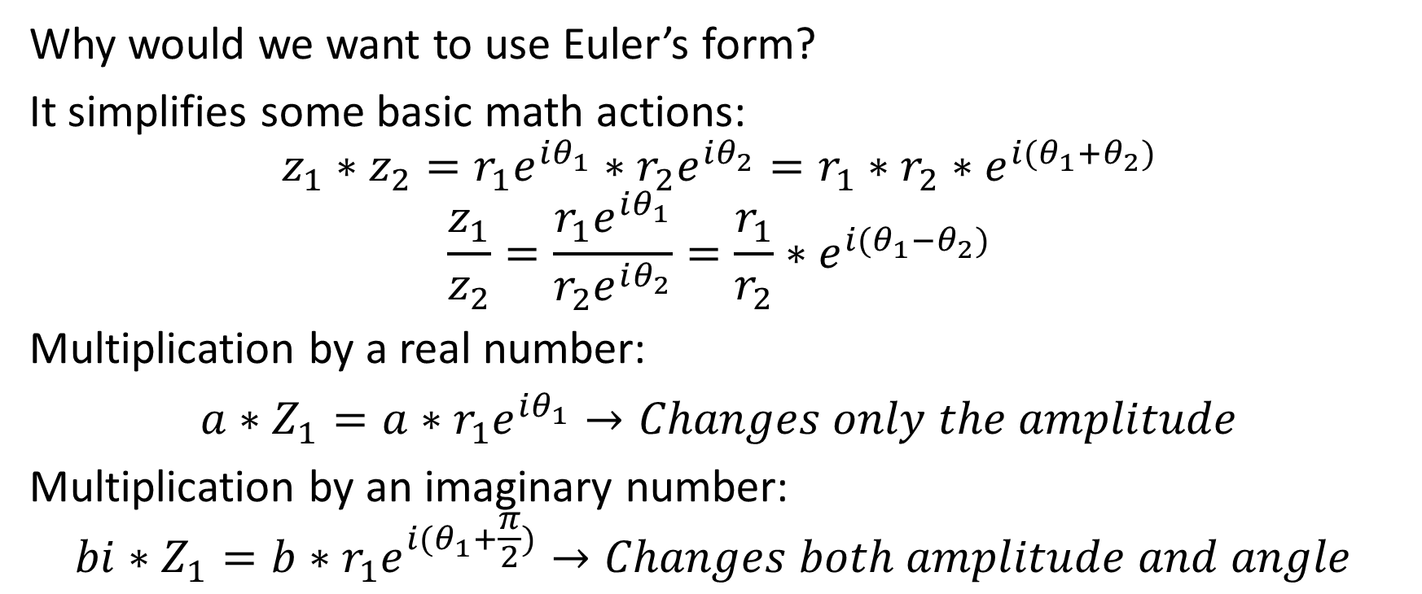
Complex numbers in polar form

Slide 8
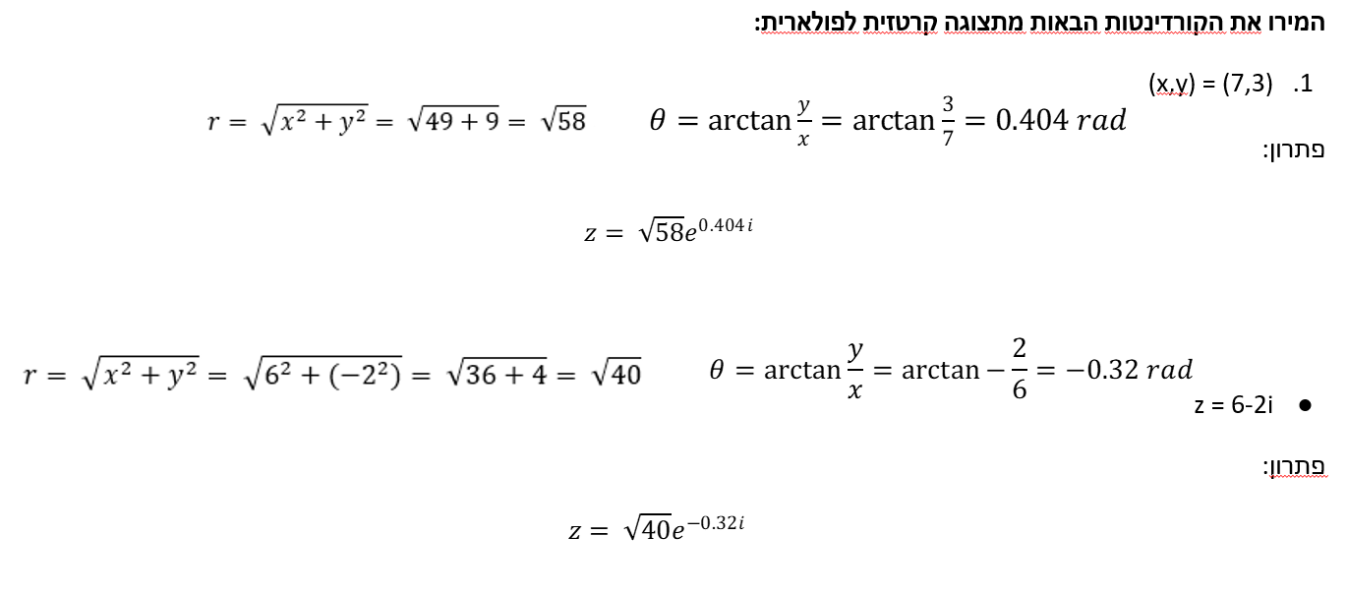
Examples
Notes:
\לשנות את הזווית לרדיאנים

Slide 9
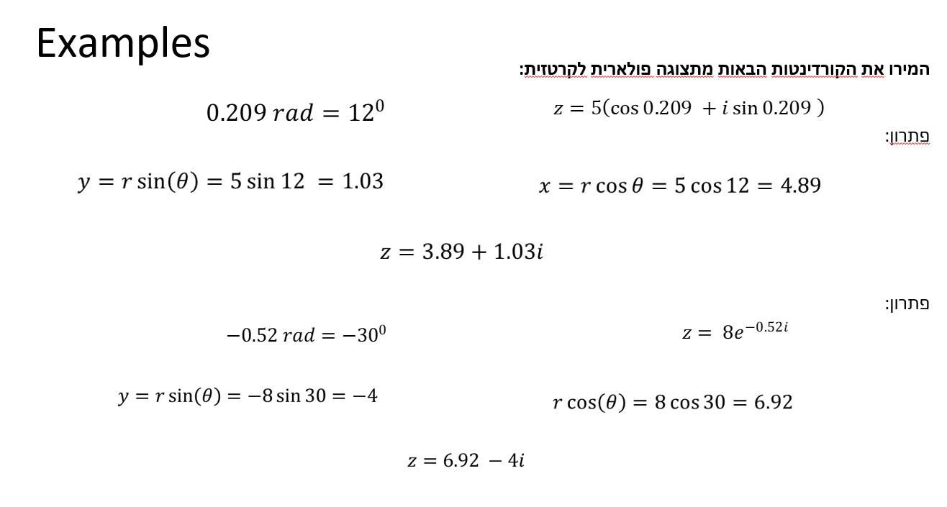

Slide 10
Real and imaginary amplitudes
The sine amplitude is represented by the imaginary part of X
The cosine amplitude is represented by the real part of X

Slide 11
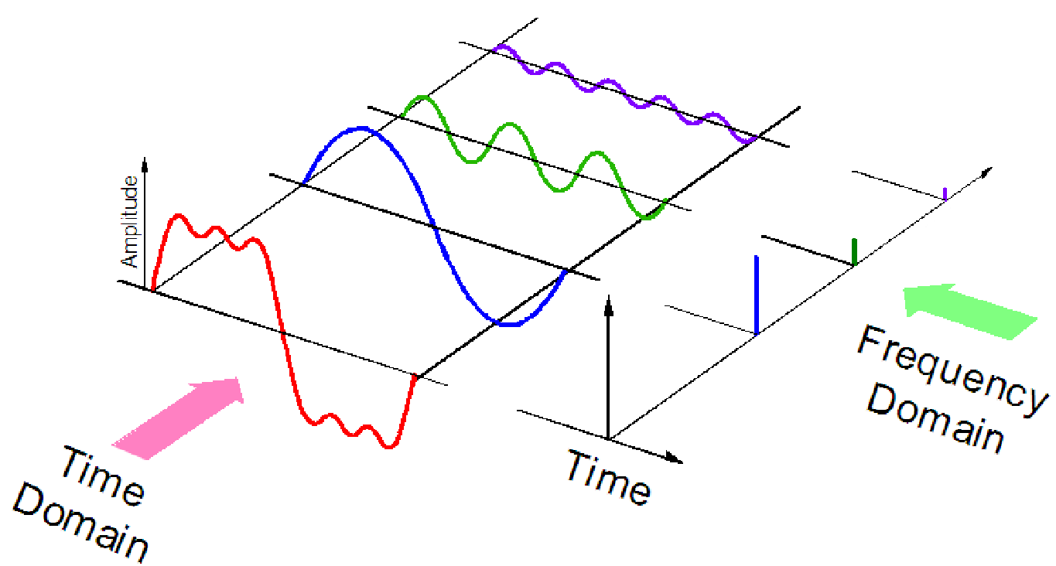
Discrete Fourier Transform (DFT)
The goal of a Fourier transform is to move from the time domain to the frequency domain. Can be accomplished since every signal can be displayed (or estimated) as a combination of sinewaves.

Slide 12

Discrete Fourier Transform (DFT)
The transform is calculated by:
N – Number of sampling points (# points in the signal)
n – Sampling index (0,1,2,…,N-1)
k - Frequency (0, 1, 2,...,N-1)

Slide 13

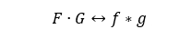
DFT - formulas and features
Inverse:
Convolution and Multiplication
(AKA “Convolution theorem”)

Slide 14


DFT - formulas and features
Parseval
linearity

Slide 15
DFT – code example

Slide 16
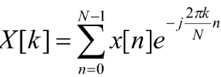
Normalize X(k)
X in the kth frequency is the sum of the multiplication of each signal value x(n) in the e^(i2*pi*k*n)/N component
Therefore we need to normalize this sum by dividing by N.
X is commonly calculated from 0 to N (and not N/2, which is the maximal reliable frequency), therefore we normalize by N/2.

Slide 17
Absolute values of X(k)
X is a complex numbers vector of length N
We are interested in the power of each X value, which correspond to a single frequency.
Therefore we apply:
normalized_dft = np.abs(normalized_dft)

Slide 18
DFT – Manual example
Calculate the DFT at 4Hz for the signal x=5*Sin(4*2π), use N=10.
First, we need to find the values of x(n)= 5*Sin(4*2π*n/N):
x(n=0)=0
x(n=1)=5*sin(4*2π*1/10)=2.939
x(n=2)=5*sin(4*2π*2/10)=-4.756
x(n=3)=5*sin(4*2π*3/10)=4.756
x(n=4)=5*sin(4*2π*4/10)=-2.939
x(n=5)=0
x(n=6)=5*sin(4*2π*6/10)=2.939
x(n=7)=5*sin(4*2π*7/10)=-4.756
x(n=8)=5*sin(4*2π*8/10)=4.756
x(n=9)=5*sin(4*2π*9/10)=-2.939
Notes:
?

Slide 19
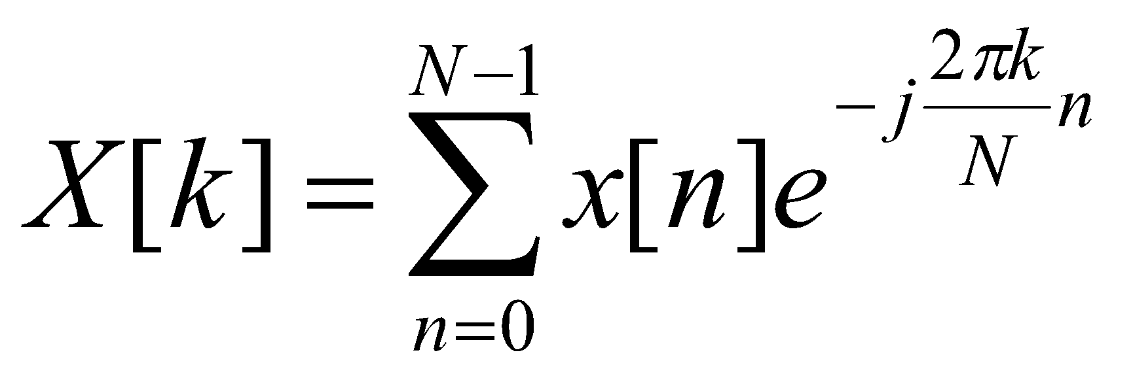
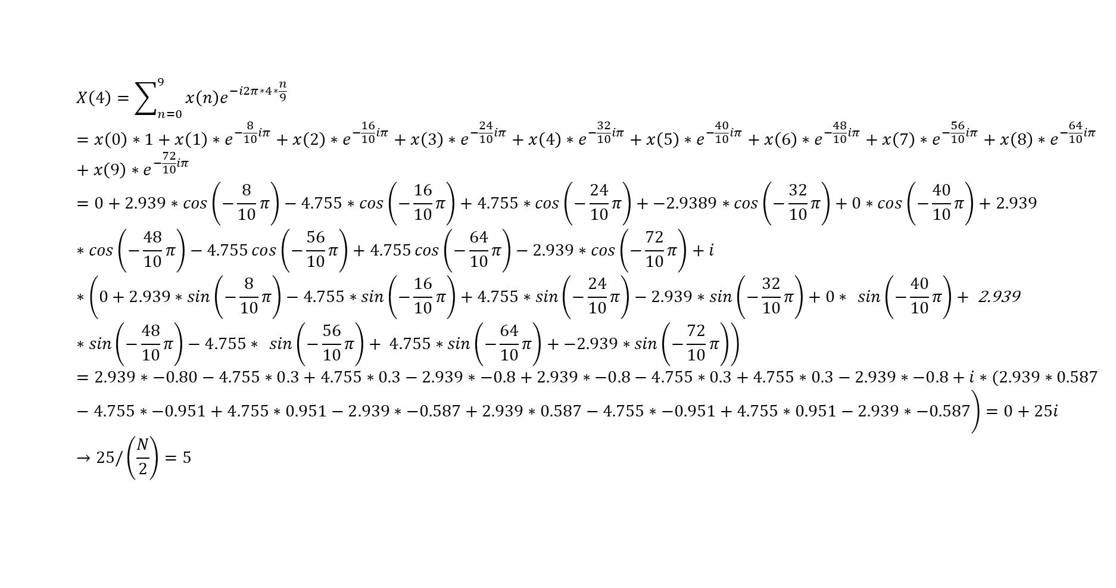
DFT – Manual example
x(n=0)=0
x(n=1)=2.939
x(n=2)=-4.756
x(n=3)=4.756
x(n=4)=-2.939
x(n=5)=0
x(n=6)=2.939
x(n=7)=-4.756
x(n=8)=4.756
x(n=9)=-2.939

Slide 20
Question:
Assume you computed a 8 points DFT in one second (e.g use t=0:1/8:1-1/8 or t=(0:7)/8) on signal x to obtain X. what you expect the X values to be if (verify with fft in matlab):
a. x=1*sin(2*pi*t*2)
b. x=5*cos(2*pi*t*3)
c. x=2*cos(2*pi*t*2) +2*cos(2*pi*t*1)
d. x=2*cos(2*pi*t*3) -2*cos(2*pi*t*1)
e. x=4*sin(2*pi*t*1)+3*cos(2*pi*t*5) % note the nyquist frequency

Slide 21
Real and imaginary amplitudes
The sine amplitude is represented by the imaginary part of X
The cosine amplitude is represented by the real part of X

Slide 22
How do we read the DFT result?
When we apply a Fourier transform on a signal x(n), we will get X(k) a series of complex numbers (same length of the original signal).
At each value k, the real part of the complex number describes the amplitude of a Cosine wave at a given frequency, and the imaginary part describes the amplitude of a Sine wave at the same frequency.
We can obtain them in matlab by using:
Real(X) and Imag(X) functions

Slide 23
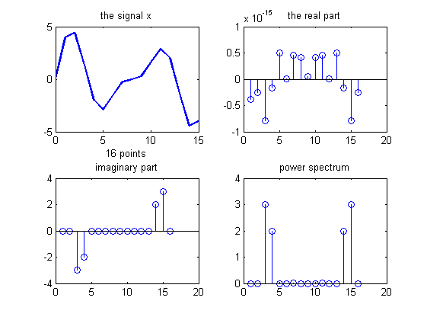
Examples x=3*sin(2*π*2) + 2*sin(2* π*3)
: real(x)
: imag(x)
: abs(x)

Slide 24
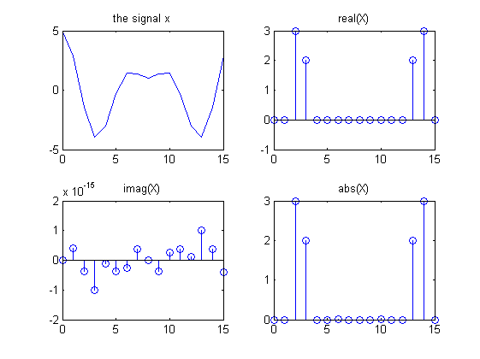
Examples x=3*cos(2*π*2) + 2*cos(2* π*3)

Slide 25
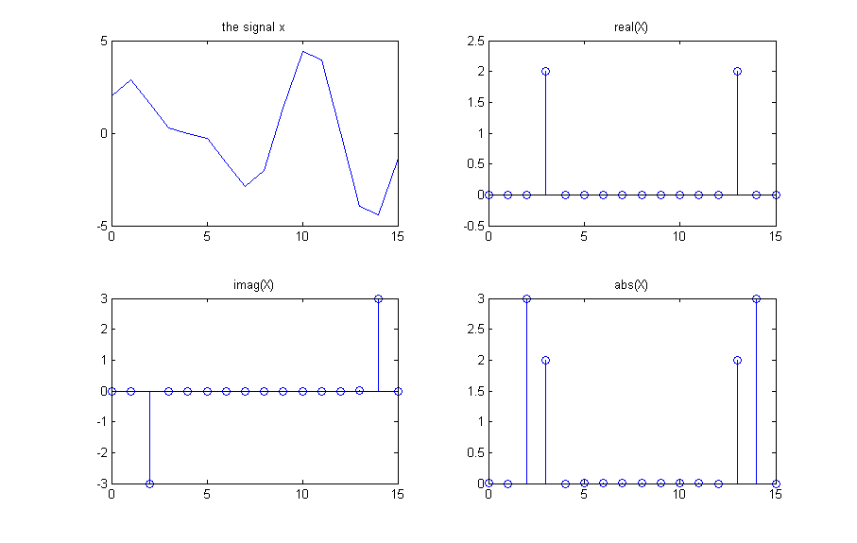
Examples x=3*sin(2*π*2) + 2*cos(2* π*3)

Slide 26
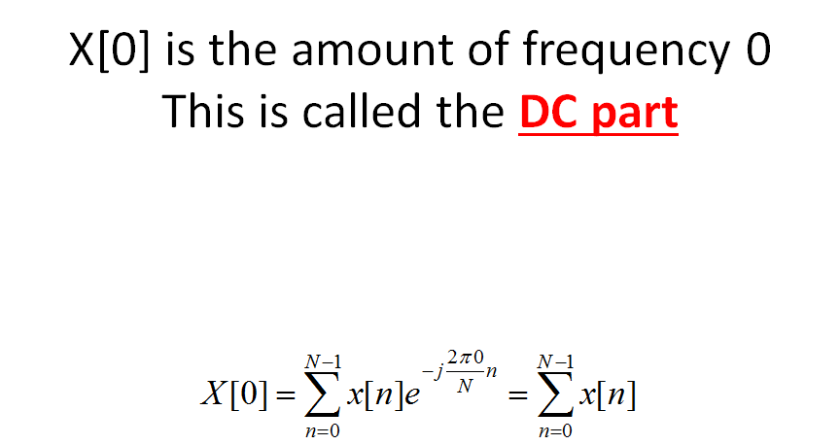
We normalize the DC value by N
(Remember that we normalize all the other values by N/2)

Slide 27
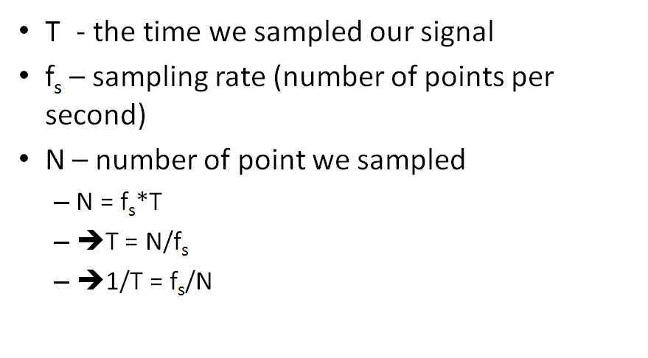
Resolution of DFT

Slide 28
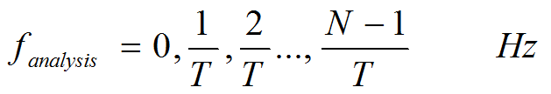
Resolution of DFT
Example
We have a 5 seconds signal, and Fs = 10Hz.
How many points do we have (N)?
What is the resolution of F_analysis?
What is the nyquist frequency (what is the center of the DFT graph)?

Slide 29
Resolution of DFT
Solution
We have a 5 seconds signal, and Fs = 10Hz.
How many points do we have (N)? 50 points
What is the resolution of F_analysis? 1/5Hz
What is the nyquist frequency? 5Hz

